Slide 1
Why Python?

Slide 2
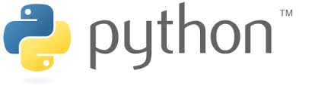
Why Python?
Ease to learn and code/use
Can be learnt in a very short amount of compared to other languages
Easy to understand syntax, highly readable
Easy to develop complex code

Slide 3
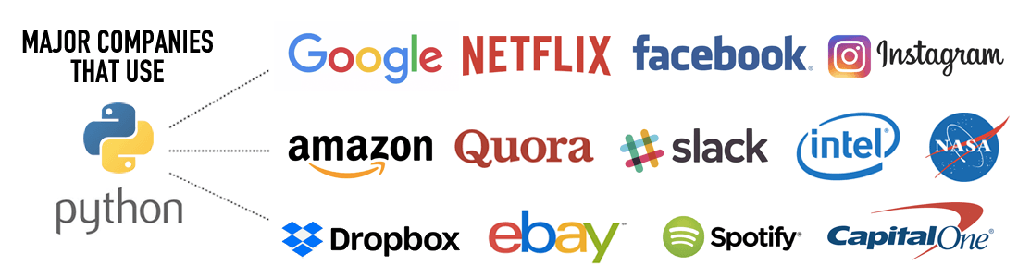
Why Python?
A huge number of Sponsor
A lot of well known companies use python

Slide 4
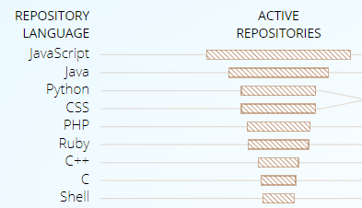


Why Python?
A very vast community
A very huge open source community
A lot of python users, from students, developers to Professors

Slide 5
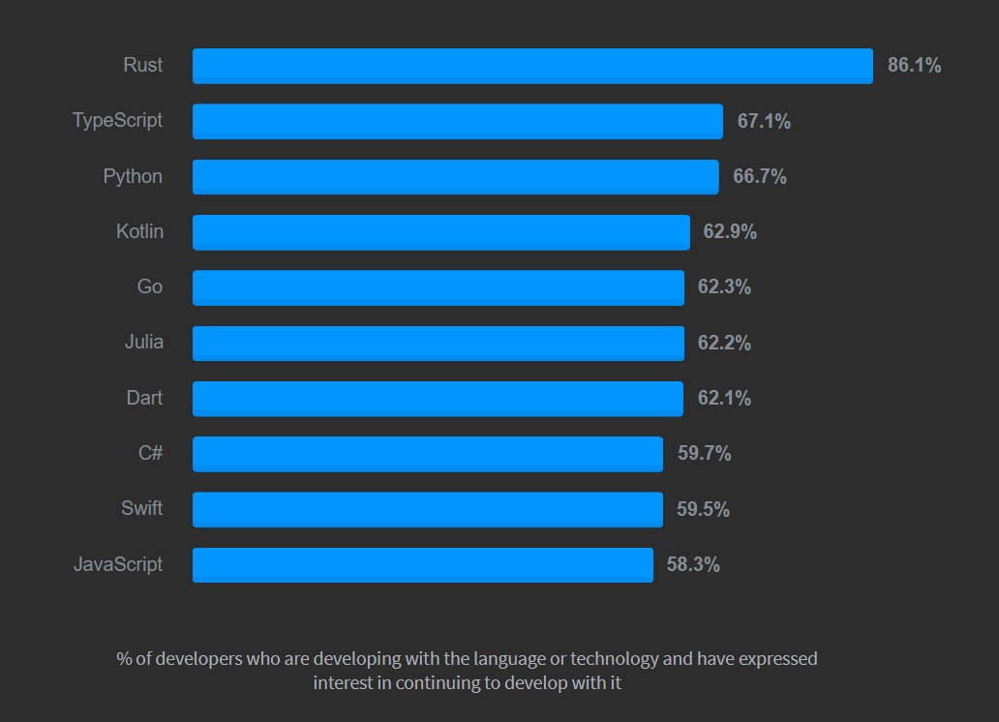

Slide 6
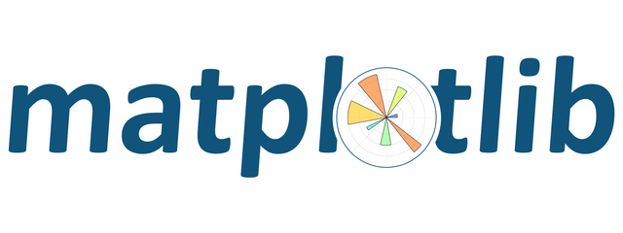
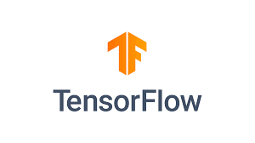


Why Python?
A large amount of libraries and frameworks
Web Development frameworks -Django
Machine learning – Keras, Scipy
Visualization - MatplotLib
Mathematical/ Statistics assistance – Numpy
Game development – PyGame
GUI development – tkinter, PyQt
Database – PyMongo, PyMySQL
CyberSecurity – Nmap, Yara

Slide 7
Why Python?
Versatility, efficiency and reliability
It can be used in many varieties of environments such as mobile applications, desktop applications, web development, hardware programming, and many more
It runs on almost on every operating system without any issues any issues
Relatively a lot less to code when compared to languages like C++, C, Java etc

Slide 8



Why Python?
Machine Learning and Data Science
Goto language for AI development after R
A very vast amount of libraries like Tensorflow, PyTorch, Keras, OpenCV etc

Slide 9
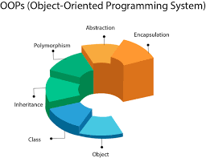
Why Python?
Multiple programming paradigms
Object oriented programming, structured programming, functional programming
Dynamic type system
Automatic memory management

Slide 10

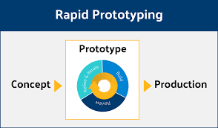
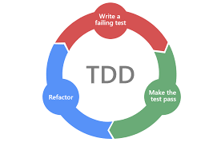
Why Python?
Rapid prototype development
Quickly put a concept into practice
Engages a test driven development

Slide 11
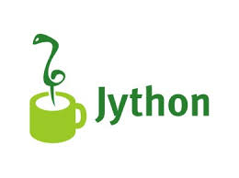
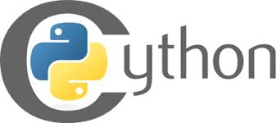
Why Python?
Intregration with other languages
Jython – Python integrated with Java.
CPython – Python integrated with C.
Rpy and many more

